Slide 1
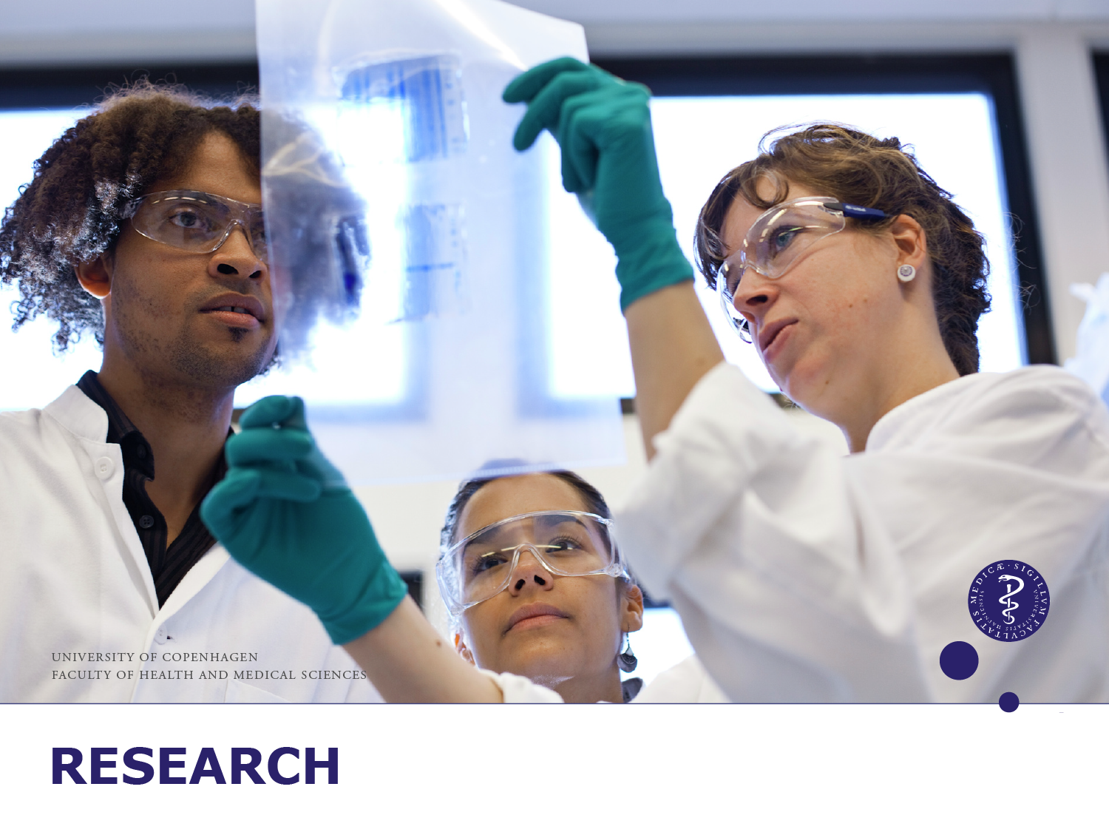
Notes:
RESEARCH

Slide 2
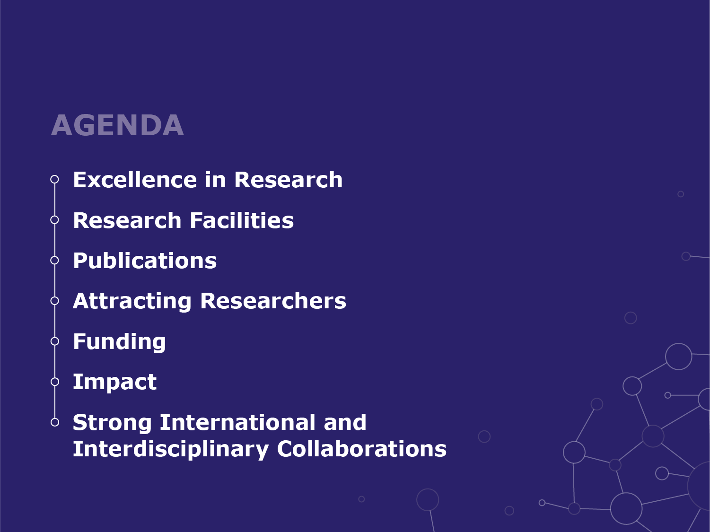
Notes:
AGENDA

Slide 3

Notes:
EXCELLENCE IN RESEARCH

Slide 4
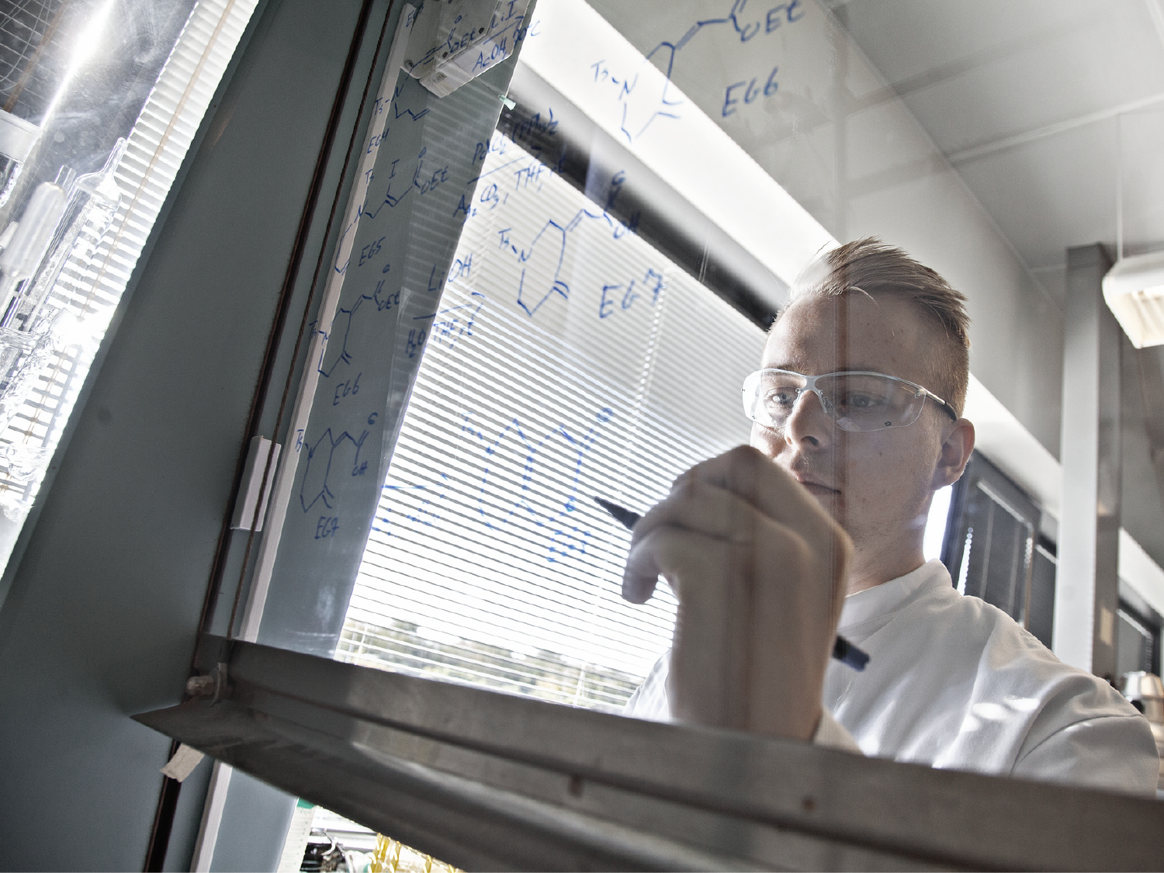
Highly Qualified Graduates
Enhancing
Research Impact
Recruiting and developing talent
Creating excellent environments and facilities
Strengthening international and interdisciplinary collaborations
Offering a competitive infrastructure
Increasing external funding
Securing responsible conduct of research
Research-based study programmes
Research-based teaching
An inspiring, international environment
A close relationship with networks and partners
Nurturing talent and keeping students motivated
We use online technology for training
Notes:
ENHANCING RESEARCH IMPACT

Slide 5
Research in numbers
302,000 m²
Building floor space
1,550
PhD students
3,000
Scientific staff*
EUR 241 million
External research funding
22,500
Publications
(2013-2017)
Source: SUND Research and Innovation 2019 (PhD students, Scientific staff, publications and external research funding) and SUND Campus Service 2019
Notes:
RESEARCH IN NUMBERS
*Including PhD students.
(Illustrations on this slide are in rounded figures.)
Staff counted as headcount

Slide 6
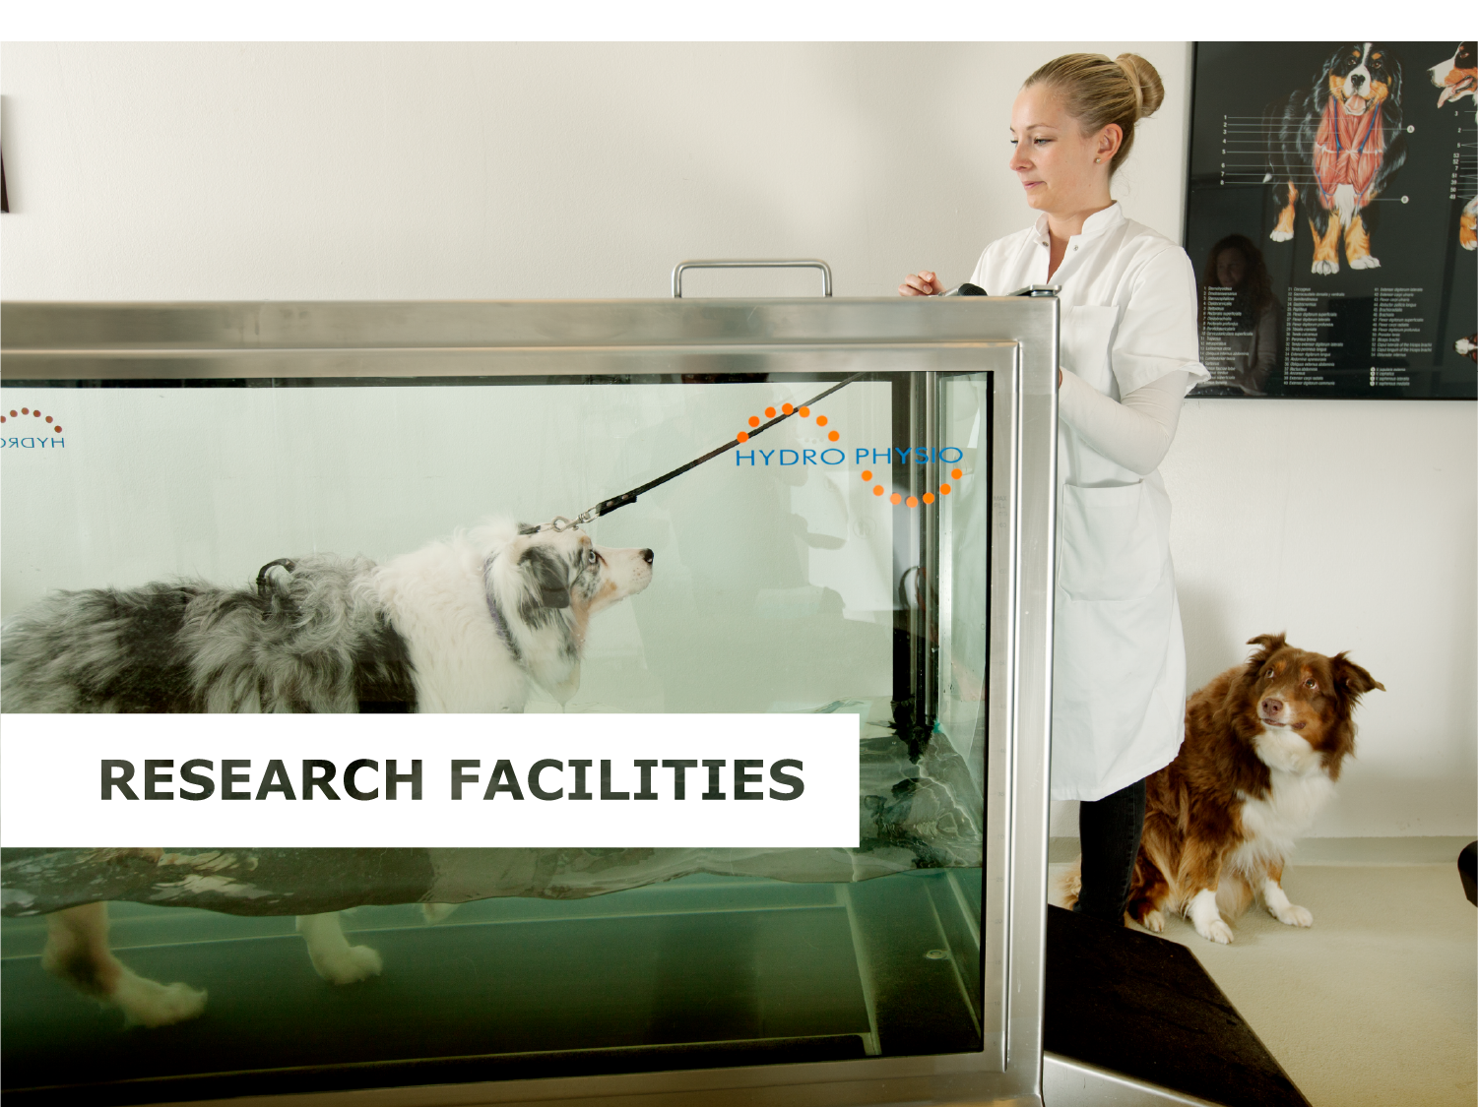
6
Notes:
RESEARCH FACILITIES

Slide 7
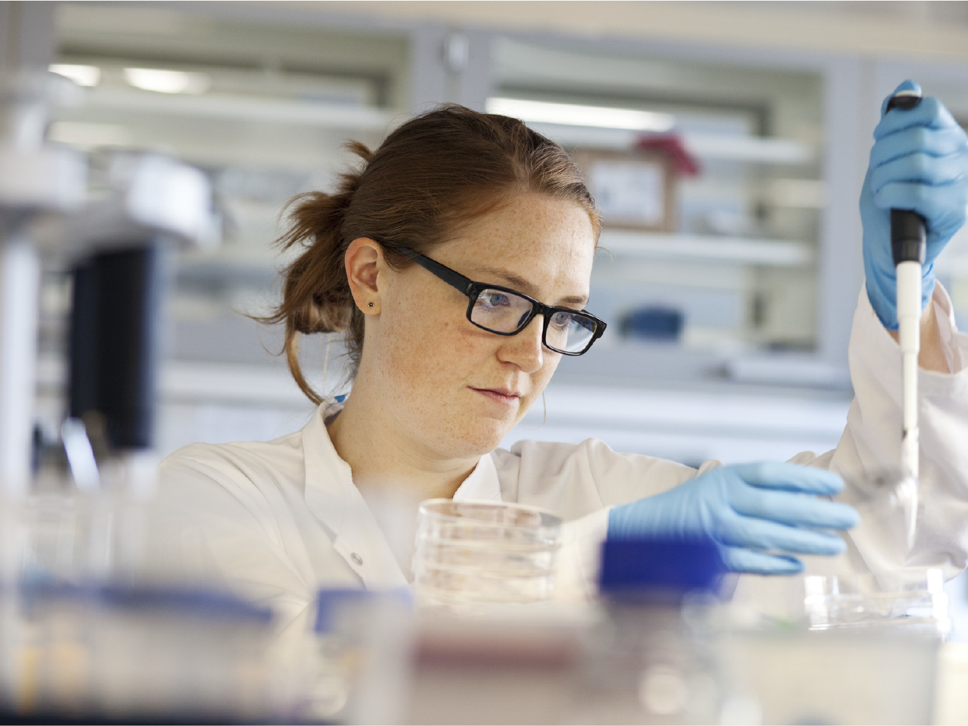
Strong research
infrastructure
Animal facility at Department of Experimental Medicine
Core facility for transgenic mice
Zebrafish facility
Core facility for Integrated Microscopy
Nuclear Magnetic Resonance facility
Cryo-electron microscope facility
Mass Spectrometry Platform
European Spallation Source Data Management and Software Center
Section of Biostatistics and Good Clinical Practice unit
Databases, biobanks, bioinformatics and big data. E.g. Computerome – a new supercomputer for Life Sciences
Notes:
STRONG RESEARCH INFRASTRUCTURE
Good conditions are crucial to excellent research and education. Good conditions create opportunities and new ideas, promote learning and encourage interaction.
The fundamental framework of SUND includes both our buildings, the rooms in which we work, the infrastructure we make available and the administrative services provided.
Talented staff and external funding are drawn to the places that have the best conditions for success. SUND is constantly improving its Infrastructure and physical facilities in order to enhance our competitiveness in the years to come.
Computerome: The Technical University of Denmark (DTU) and the University of Copenhagen (UCPH) invest in a new super computer for Denmark. A new giant computer - Computerome 2 - replaces the previous version. The computer is a vital resource for undertaking ambitious research projects, among other things in personalised medicine and in developing new drugs based on understanding the mechanisms of disease and their biology. Danish life science research is getting a strong basis for ongoing international collaboration, ultimately for the benefit of treating the general public.

Slide 8
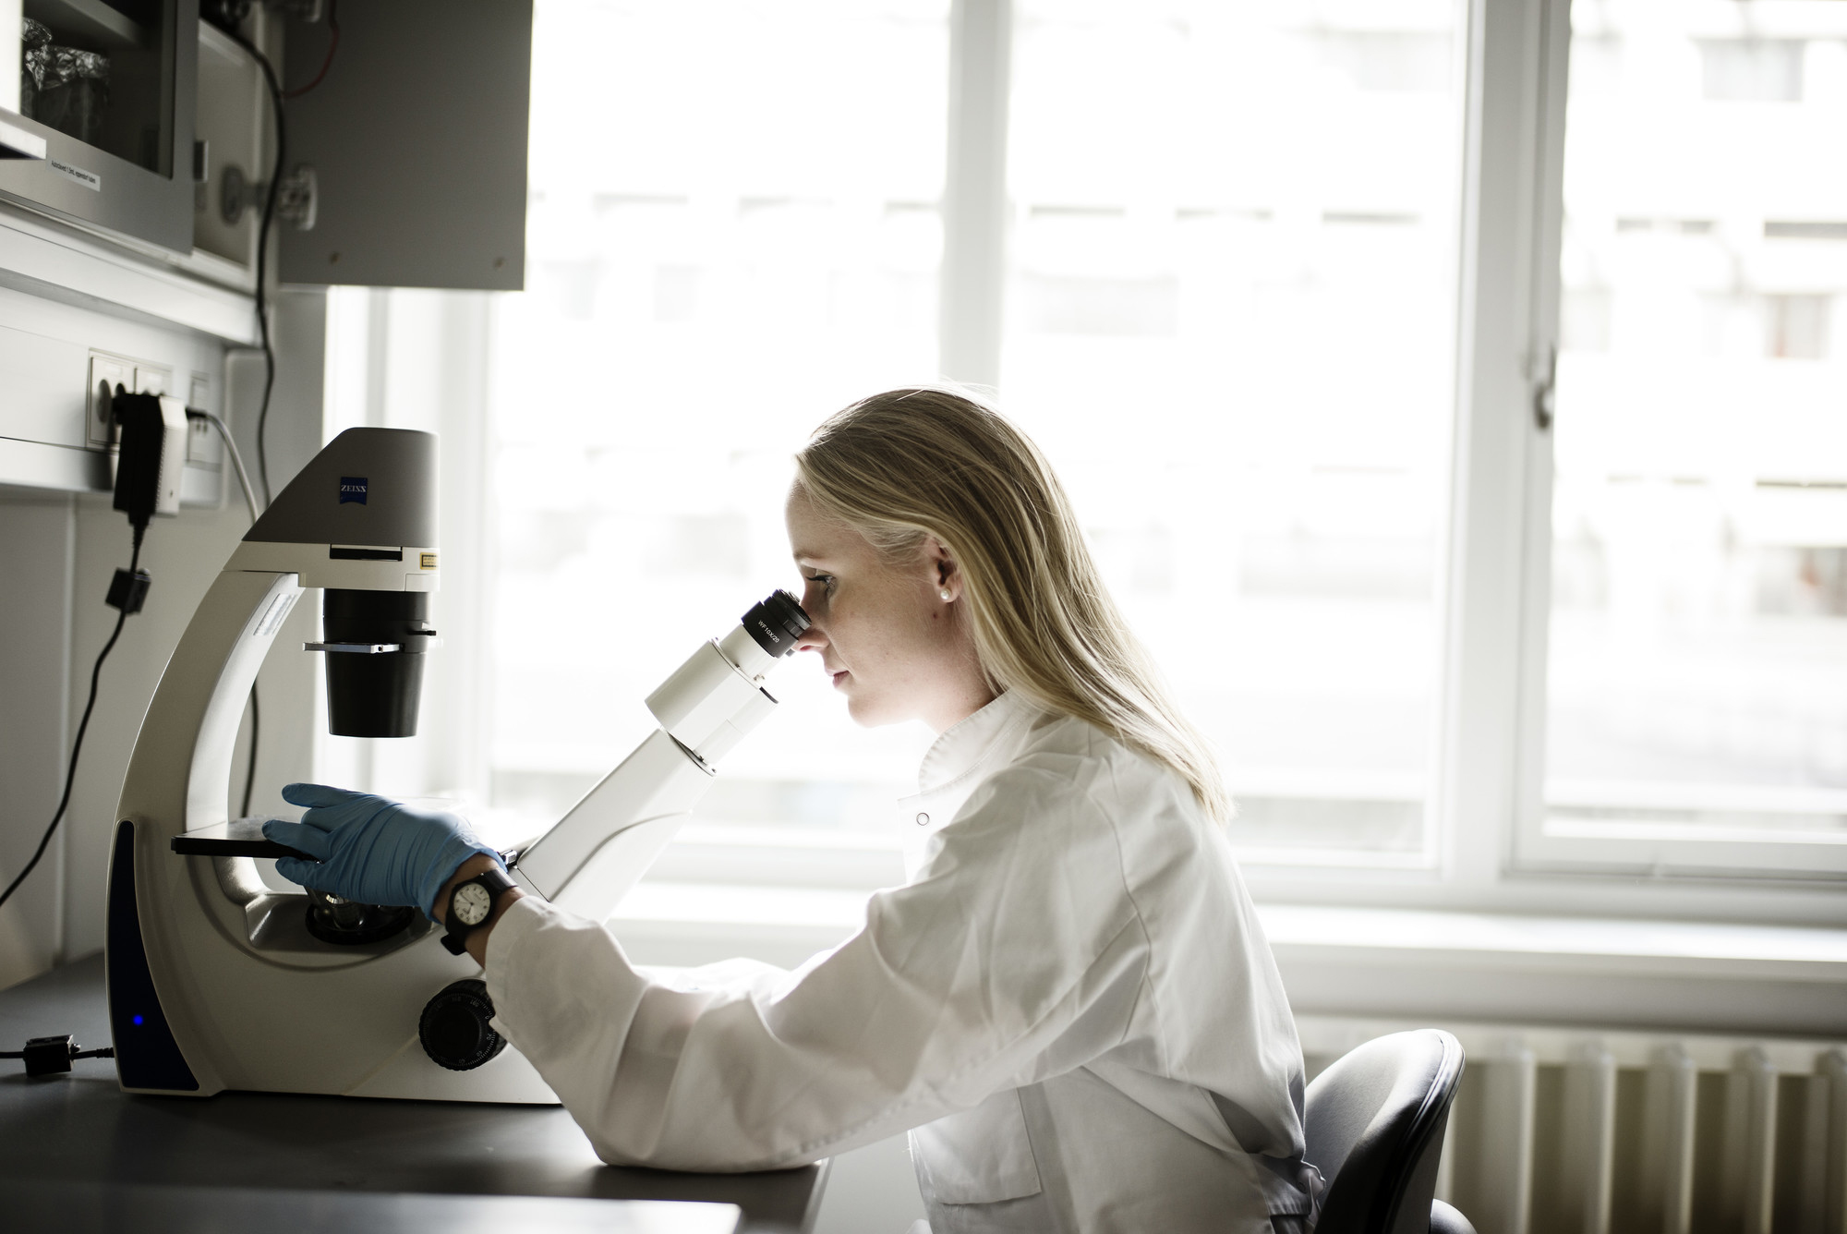
Excellent Research Centres
Excellent Research Centres
Novo Nordisk Foundation Center for Protein Research (CPR)
Novo Nordisk Foundation Center for Basic Metabolic Research (CBMR)
Novo Nordisk Foundation Center for Stem Cell Biology (DanStem)
Biotech Research and Innovation Centre (BRIC)
Center for Translational Neuromedicine (CTN)
Notes:
EXCELLENT RESEARCH CENTRES
A range of centres have emerged from the expertise and strengths of the faculty. Some are basic research centres, others interdisciplinary centres. Some enjoy generous private funding, others public funding.
All centres contribute greatly to the rich research environment at SUND, which attracts academics from all over the world.

Slide 9

Notes:
PUBLICATIONS

Slide 10










TOP 10 PUBLISHING COLLABORATIONs
Source: SUND Research and Innovation, 2019
Notes:
TOP 10 PUBLISHING COLLABORATIONS
The 10 institutions with which SUND most often co-publishes. The top three international collaborators are Karolinska Institutet, Lund University and Harvard University.
(Source: SUND Research and Innovation, 2019)

Slide 11
International Co-autHors
Source: SUND Research and Innovation, 2019
Notes:
INTERNATIONAL CO-AUTHORS
The chart shows the number of SUND publications with a co-author from a foreign institution in the period 2012-2016. Approximately 50 % of our publications have a co-author from a foreign institution.
In 2015, 52.3% of publications produced by SUND were co-authored by at least one foreign institution.
(Source: SUND Research and Innovation, 2019)

Slide 12
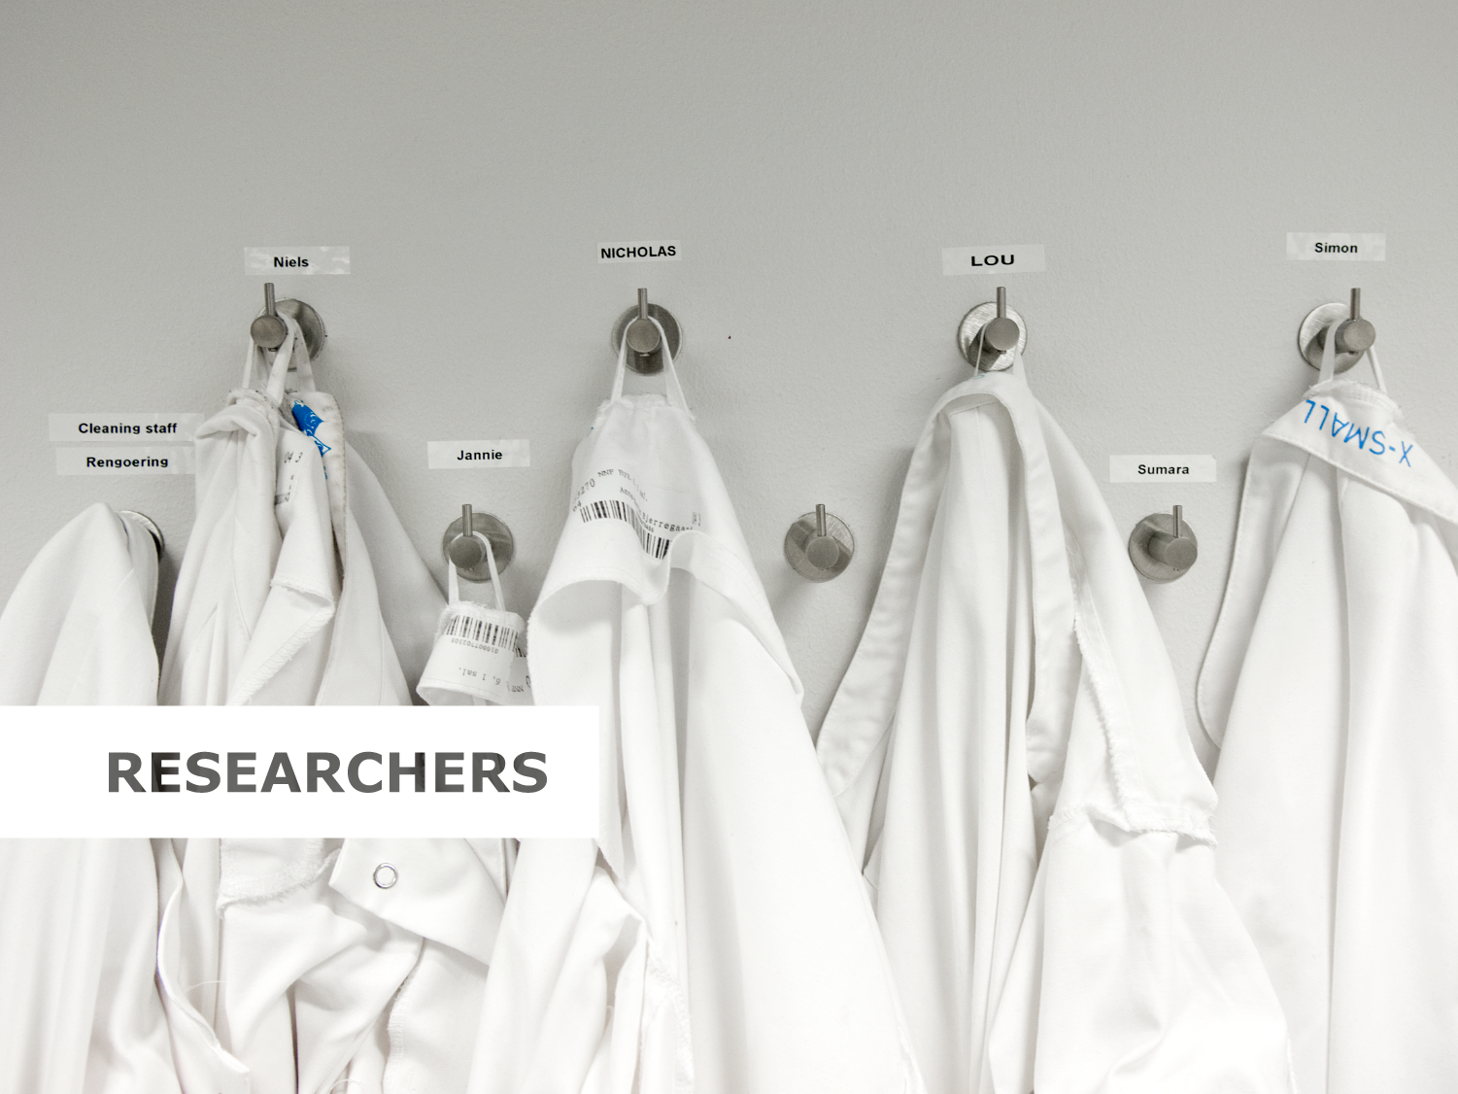
Notes:
RESEARCHERS

Slide 13
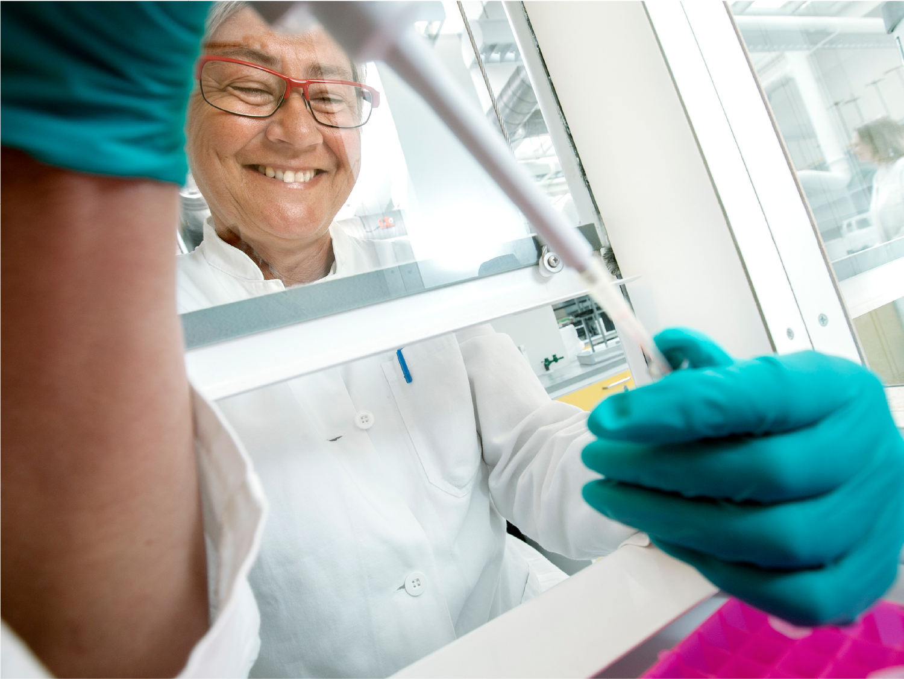
attracting
the best researchers
Create excellent research and educational environments
Provide international and online training
Interact with the world’s best research hubs
Offer a competitive infrastructure
Strive to participate in prestigious national and international research projects
Create a knowledge-based dialogue with society
Notes:
ATTRACTING THE BEST RESEARCHERS
The recruitment and development of researchers is a strategic priority. Health Copenhagen will use its dynamic research culture to attract, motivate, develop and retain the highly valued faculty. It is essential that we provide Health Copenhagen with the development opportunities required to attract and retain the best.
Ownership of and participation in prestigious, national and international research projects presupposes excellent scientific quality. It also requires initiative on the part of individual researchers, a modern infrastructure and collaboration with the right administrative resources.

Slide 14
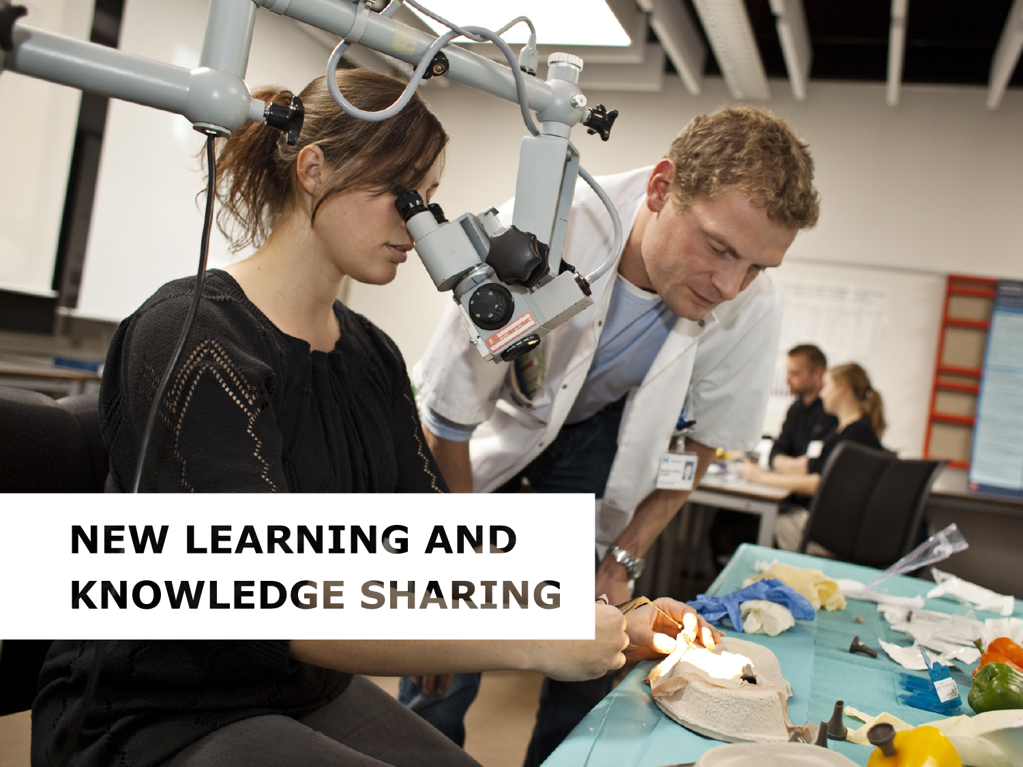
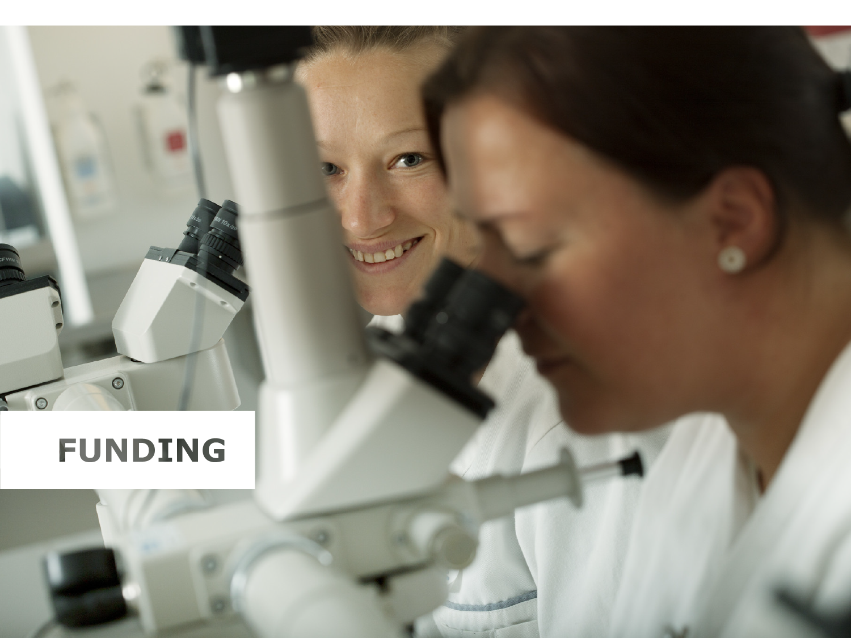
Notes:
FUNDING

Slide 15
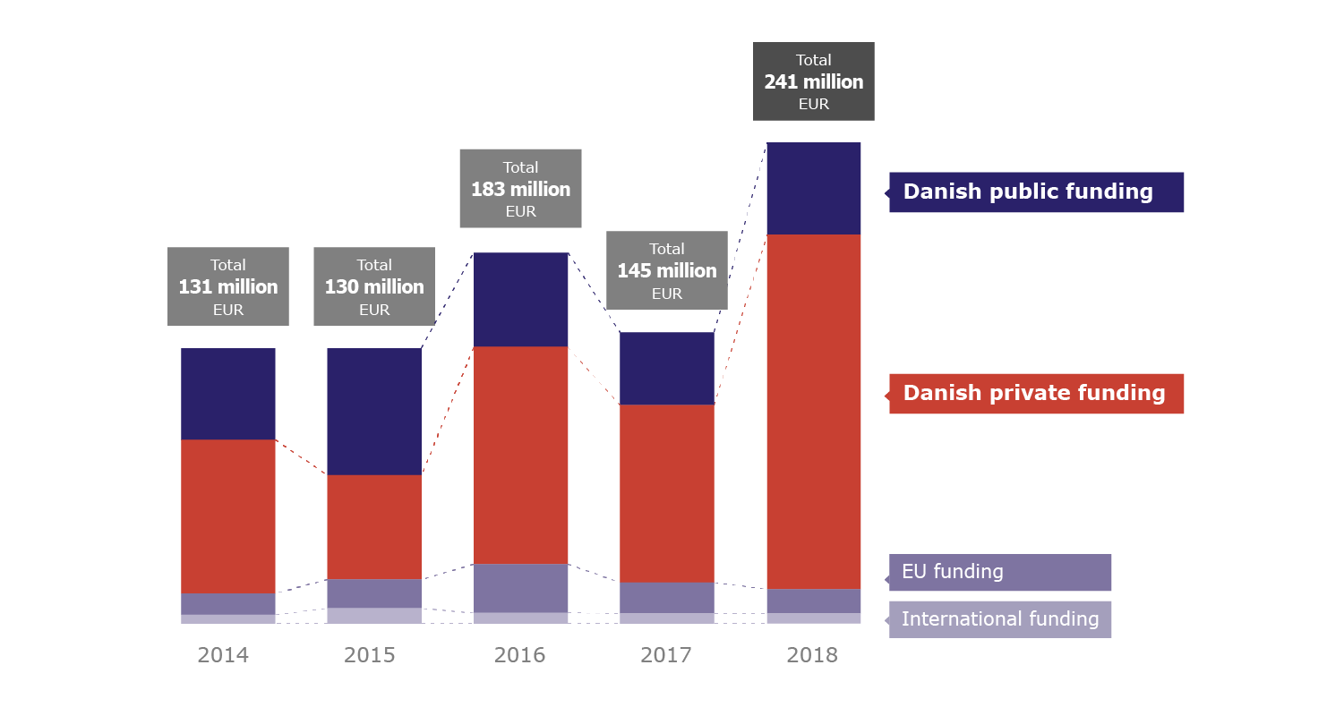
Research funding
External research funding at SUND
Source: SUND Research and Innovation, 2018
Notes:
RESEARCH FUNDING
The chart shows significant variation in Danish private funding received at SUND. This is due to the fact that we received several large private grants in 2014. Among others, the Department of Biomedical Sciences received DKK 109 million from Nordea-fonden and the Novo Nordisk Foundation, respectively, while the Center for Basic and Translational Neuroscience received DKK 80 million from the Novo Nordisk Foundation divided between two DKK 40-million Laureate Research Grants, a much coveted grant.
The next few years will see a decrease in public funding available due to government budget cutbacks. On the other hand, Novo Nordisk doubled its funding budget for 2017, and there is generally an increase in private funding.
External funding of research activities represents an increasing part of the faculty’s total budget and is a main priority area. In a time where both basic research funding and student FTE income are under pressure, it is important to maintain the positive development in attracting external funding from national and international sources – private as well as public.
The three largest Danish public funding sources in the period 2013-2017 were the Danish Council for Independent Research – Medical Sciences (FSS), the Danish Agency for Science and Higher Education and the Danish Counsil for Independent Research – Technology and Production Sciences (FTP).
The three largest Danish private funding sources in the period 2013-2017 were the Novo Nordisk Foundation, the Lundbeck Foundation and Danish Cancer Soceity
(Source: SUND Research and Innovation, 2017)

Slide 16
Top 20 sources of external funding
Source: SUND Research and Innovation, 2019
Notes:
TOP 20 SOURCES OF EXTERNAL FUNDING

Slide 17

International recognition
The European Research Counsel awards research grants for high-quality research in Europe.
ERC Starting Grants: to encourage young talented research leaders.
ERC Consolidator Grants: to support researchers who want to establish their own research teams.
ERC Advanced Grants: to allow outstanding research leaders.
E.g. Associate Professor Troels Scheel from the Department of Immunology and Microbiology received the prestigious ERC Starting Grant in 2018.
Source: SUND Research and Innovation, 2019
Notes:
ERC GRANTS
The European Research Council (ERC) provides funding for pioneering research projects of scientific excellence in all disciplines.
There are three different ERC GRANTS:
ERC Starting Grants are designed to encourage young talented research leaders to gain independence in Europe and to build their own careers. The scheme targets promising researchers who have the proven potential of becoming independent research leaders.
ERC Consolidator Grants are designed to support researchers who want to establish their own research teams and continue to develop a successful career in Europe. The scheme also strengthens independent and excellent newly established research teams.
ERC Advanced Grants are designed to allow outstanding research leaders of any nationality and any age to pursue ground-breaking, high-risk projects in Europe. The scheme targets researchers who have already established themselves as top independent research leaders.
Associate Professor Troels Scheel from the Department of Immunology and Microbiology received the ERC Starting Grant of 1.5 million euro, and can over the next five years establish a research group focussing on a ground-breaking research idea. His research group focus on virus infections. In contrast to bacteria, viruses are dependent on the cells they infect, and it is therefore important to understand the interaction between virus and host cell. The research group focusses on the molecular mechanisms in particular and are especially interested in RNA, as many viruses contain genes from RNA, not DNA. Further, RNA based therapy is a promising new field.
(Source: SUND Research and innovation, 2019)

Slide 18
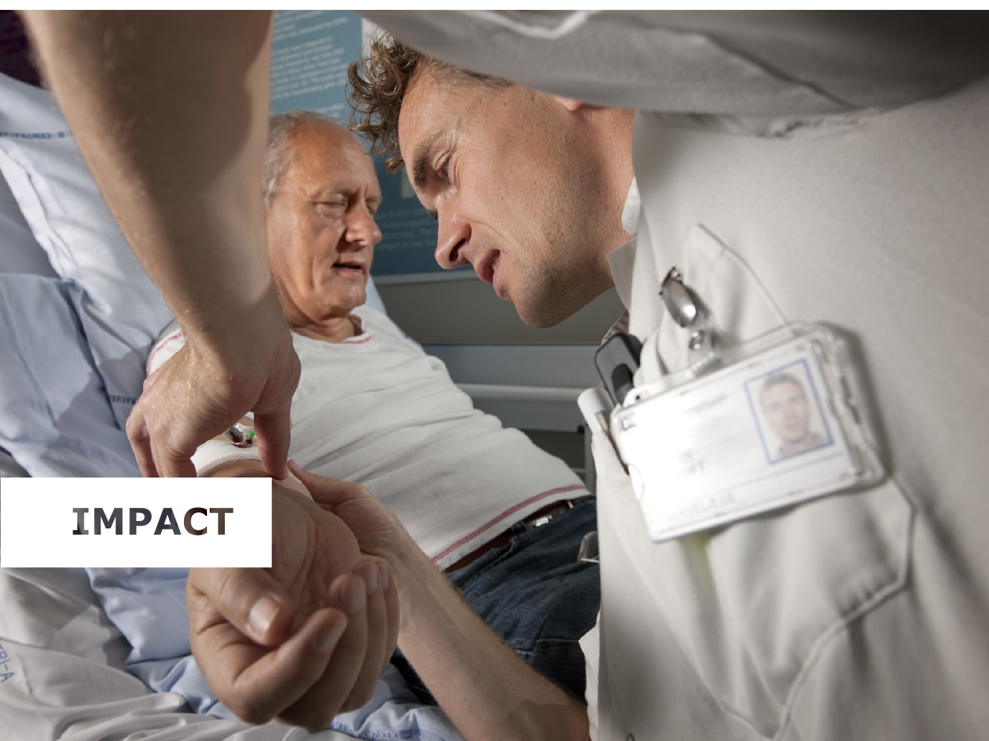
Notes:
IMPACT

Slide 19
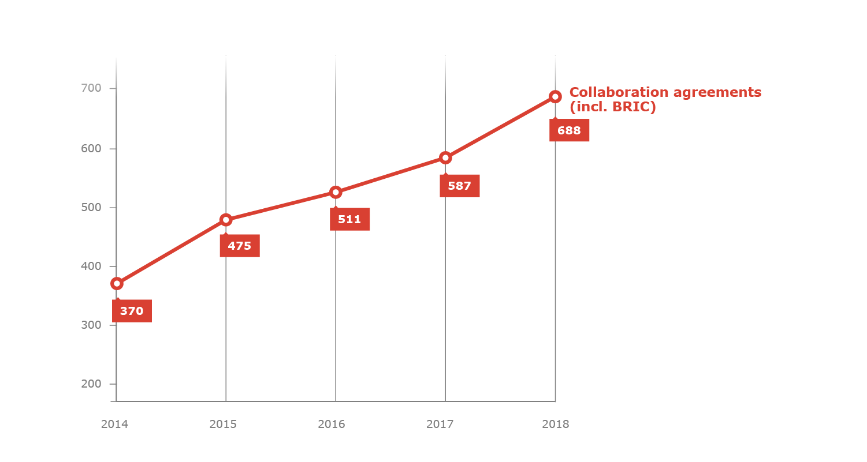
Agreements
Source: UCPH, Technology Transfer Office 2018
Notes:
AGREEMENTS
The chart shows an increase in the number of cooperation agreements at SUND.
Cooperation agreements cover the following agreements:
Research cooperation agreements
Revenue-funded activities
Clinical trial agreements
Confidentiality/non-disclosure agreements (CDA/NDA)
Material transfer agreements (MTA), incoming and outgoing
Co-financed PhDs
Industrial PhDs
EU Grant Agreements
Contracts with Innovation Fund Denmark
Development of courses and e-learning programmes for businesses
Creation and maintenance of databases
Education cooperation agreements

Slide 20
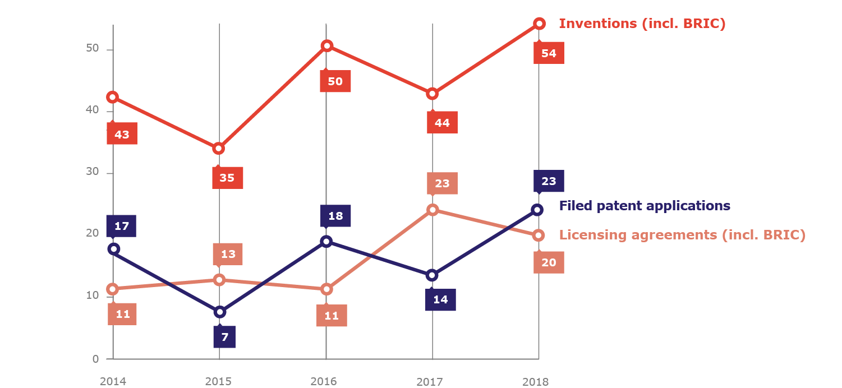
Patents, inventions and licensing agreements
Source: UCPH, Technology Transfer Office 2018
Notes:
PATENTS
In 2017 SUND entered into 23 licence agreements.
Year after year, the University of Copenhagen is responsible for a large majority of all licence agreements on patented inventions made by Danish research institutions.
At the University of Copenhagen inventions are typically commercialised through licence agreements with Danish or foreign companies, where the university transfers the right to use (but not the ownership of) one or more inventions. The university enters into licence agreements with both existing and newly established businesses (spin-outs).

Slide 21
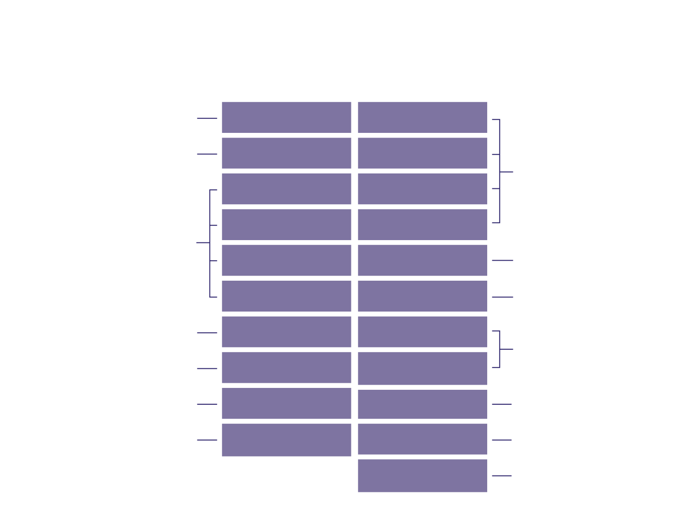
SUND Spin-outs
Biotech Research &
Innovation Centre (BRIC)
EpiTherapeutics
(2008)
Tenacious IVS
(2014)
Department of
Veterinary and
Animal Sciences
Bojesen og Petersen Aps (2012)
Medilet Aps
(2014)
Department of
Pharmacy
Neoloch Aps
(2008)
DepXplora Aps
(2012)
Department of
Neuroscience
and Pharmacology
Phlogo Aps
(2008)
FIDA-Tech Aps
(2012)
ENKAM
(2000)
Avilex Pharma Aps
(2013)
Department of
Drug Design and
Pharmacology
Reticare IVS
(2015)
InProther Aps
(2012)
Department of
Immunology and
Microbiology
Department of
Biomedical Sciences
Antag Therapeutics
(2017)
AdaptVac
(2017)
Department of
Cellular and Molecular
Medicine
CBMR - The Novo Nordisk Foundation Centre for Basic Metabolic Research
Embark Biotech IVS (2018)
GlycoDisplay
(2017)
DanStem
PanCryos IVS (2018)
Cell2Cure ApS (2018)
Institut for Klinisk Medicin
Institut for Neurovidenskab
RetiPharma IVS
(2018)
EnteroTarget ApS (2018)
Institut for Cellulær og Molekylær Medicin
Geloprep IVS (2018)
Institut for Farmaci
Source: UCPH, Technology Transfer Office 2018
Notes:
SPIN-OUTS
The table shows how research conducted at SUND departments can lead to new businesses resulting in growth and new jobs. More and more researchers set up in business based on their research results.
The University of Copenhagen’s Tech Transfer office has managed Copenhagen Spin-outs since 2011. This is a partnership between the University of Copenhagen, the Technical University of Denmark and the Capital Region of Denmark together with a number of central stakeholders, an association of Danish biotech companies, and the Danish Association of the Pharmaceutical Industry.

Slide 22
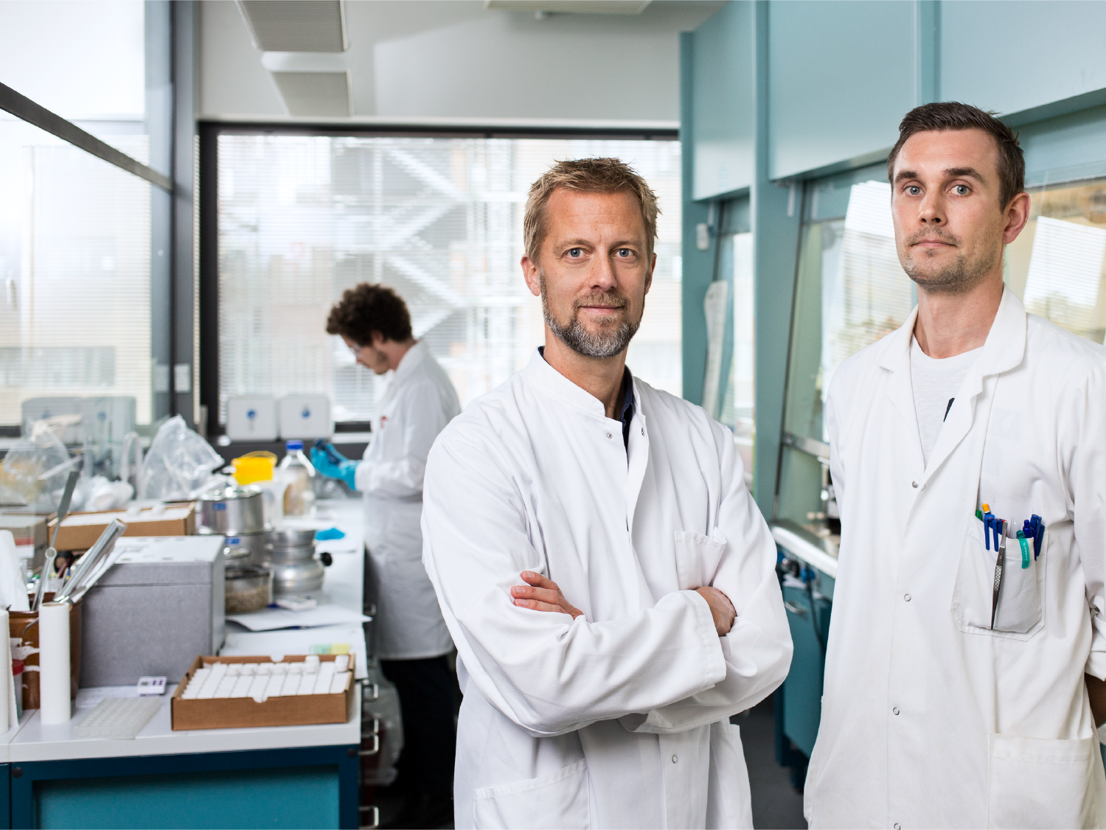
Innovation
SUND provides the framework for an ecosystem of partnerships to promote an innovative mindset
Copenhagen Health Innovation – teaching tools that imitate the real-life challenges
SUND Hub – creative student network
EIT Health - Europe’s largest public-private innovation partnership
E.g. Professor Kristian Strømgaard and Postdoc Anders Bach with Avilex Pharma
Notes:
INNOVATION
The University of Copenhagen increasingly integrates innovation at the heart of its study programmes.
The ambition is to make students develop specific solutions that benefit society already at an early stage. During their studies, students practise thinking up ideas in close collaboration with hospitals, local authorities, companies and international organisations.
The picture shows Professor Kristian Strømgaard (left) and Postdoc Anders Bach (right) from Avilex Pharma. The Chemical Biology group at the University of Copenhagen has discovered an entirely new principle for the development of pharmaceuticals and has achieved a significant breakthrough in the pain control area. This has resulted in the establishment of a new company, Avilex Pharma.
On a research level the spin-out company Avilex Pharma is a good example of research made at the faculty turning into a business example.
The University of Copenhagen distinguishes itself internationally as a centre for health innovation, where everyone with the talent, dedication and ambition to make a difference can find support and collaborators with whom to realise their ideas.
Cooperation and innovative thinking across all sectors are necessary if the health challenges facing society are to be met. Copenhagen Health Innovation is a good example of one of these interdisciplinary partnerships.
SUND Hub is for students, entrepreneurs and health professionals who want to pursue their innovative ideas within the area of health. With SUND Hub the university aims to create a meeting point for innovative students and facilitate dynamic interaction with the healthcare sector and businesses.
EIT Health is Europe’s largest public-private innovation partnership aimed to address the challenges of healthy living and active aging. EIT Health is a consortium of more than 50 core partners and 92 associate partners from leading businesses, research centres and universities from 14 EU countries.

Slide 23

Big data -
a revolution
in treatment
SUND cooperates with hospitals and other health care professionals on research and treatment using Big Data.
Data from hundreds of thousands of patients, effectively support research into the prevention and treatment of diseases.
Big data can save individuals from receiving unnecessary and ineffective treatment
Big data reduces costs for the health service
E.g. Professor Søren Brunak's research at the Novo Nordisk Foundation Center for Protein Research
Notes:
BIG DATA
The picture shows Professor Søren Brunak from the Novo Nordisk Foundation Center for Protein Research at SUND.
Researchers at SUND’s protein centre use data from thousands of blood samples to examine how protein in the blood can reveal future lifestyle diseases such as type 2 diabetes, obesity and other metabolic disorders with extensive social consequences. The results will be used to initiate early preventive treatments.
Denmark has built some of the most extensive health databases in the world. This gives the Danish healthcare system excellent conditions for using health data in research projects for the sake of disease prevention and treatment of patients.

Slide 24
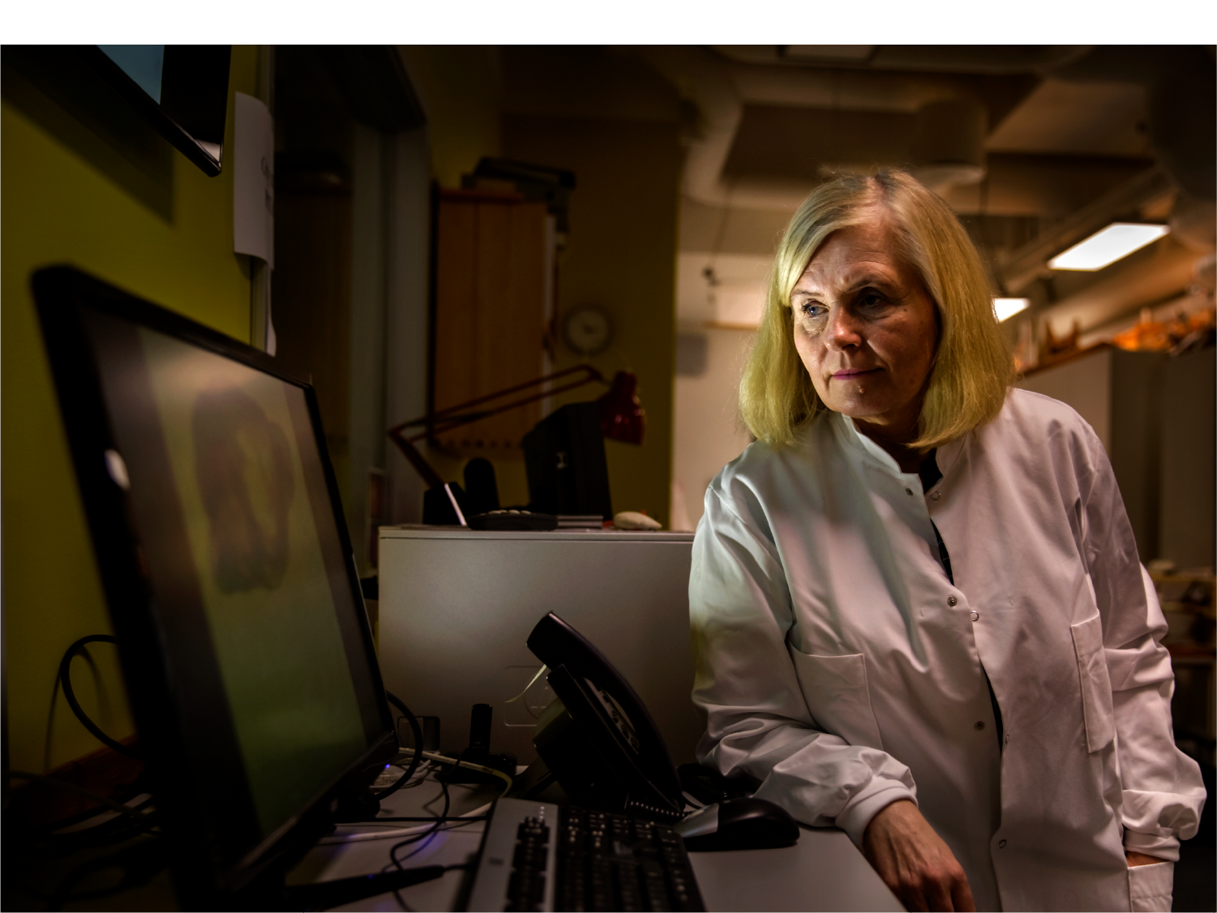
eXcellent research Impact
Research at the Faculty is of the highest international standard, and can therefore be deemed excellent.
Excellent research is essential to the largest quantum leap towards improving our health.
E.g. Professor Maiken Nedergaard. Her study has paved the way for researchers to develop a diagnostic test which can predict a person’s risk of developing dementia.
Notes:
EXCELLENT RESEARCH IMPACT
The picture shows Professor Maiken Nedergaard.
The nervous system contains more than 1,000 billion glial cells or glia. Maiken and her team are among the first researchers in the world to try to outline the actual function of the cells in the brain. This is done using MRI scans and results from sleep research.
The research also shows that the glial cells play a main role in the development of disorders like dementia, schizophrenia and ADHD.
The study enables the researchers to develop a diagnostic test predicting a person’s risk of developing dementia. This makes it possible to prevent disorders at an early stage.
Excellent research is governed by the great curiosity and will of talented researchers to increase knowledge in their field, and it often leads to surprising and ground-breaking results, improving the health of both animals and humans.

Slide 25
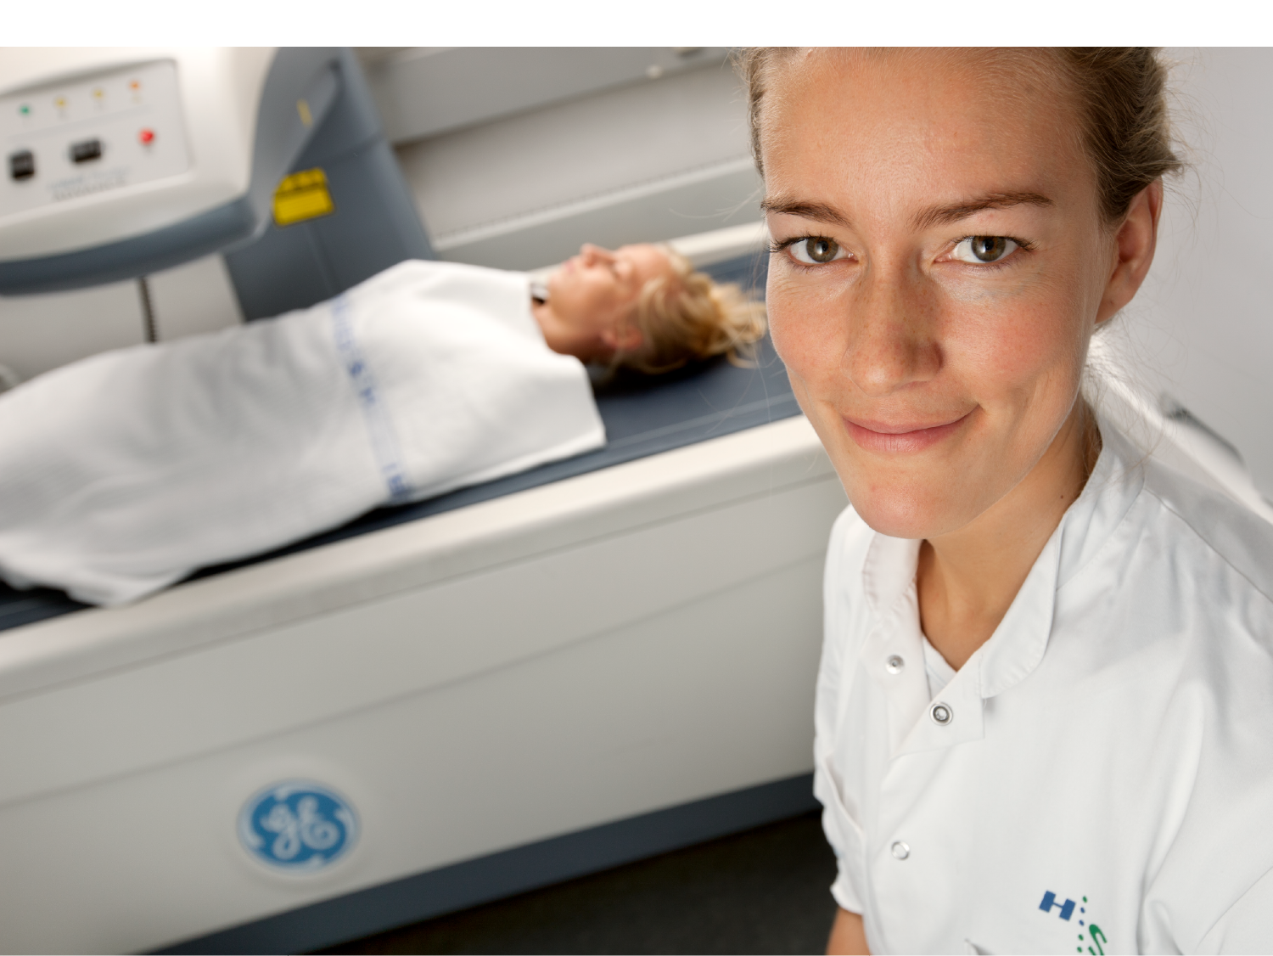
TRANSLATIONAL
RESEARCH IMPACT
Translational research is undertaken in a primary care environment, close to the patient.
Close contact with the hospitals ensures research can meet new requirements in the treatment process.
The short path from laboratory research to clinical practice benefits to the patient by offering fast and effective treatment.
Clinical Academic Groups aim to realise a joint potential.
Notes:
TRANSLATIONAL RESEARCH IMPACT Research within the health and medical sciences is often conducted in close collaboration between the university, hospitals, clinics, regions, municipalities, government agencies, patients associations and citizens. We refer to this collaboration as translational research.
The clinical and translational research places SUND in a key position in the development of treatments offered by society to citizens.
Copenhagen Health Science Partners is an example of translational research collaboration based at SUND, a partnership between the Capital Region of Denmark and the University of Copenhagen, among other things aimed at ensuring that patients get access to the latest treatment and care at an even earlier point.
Central to this collaboration is the establishment of a series of Clinical Academic Groups (CAG) aimed to realise a joint potential within a cross-disciplinary field.

Slide 26
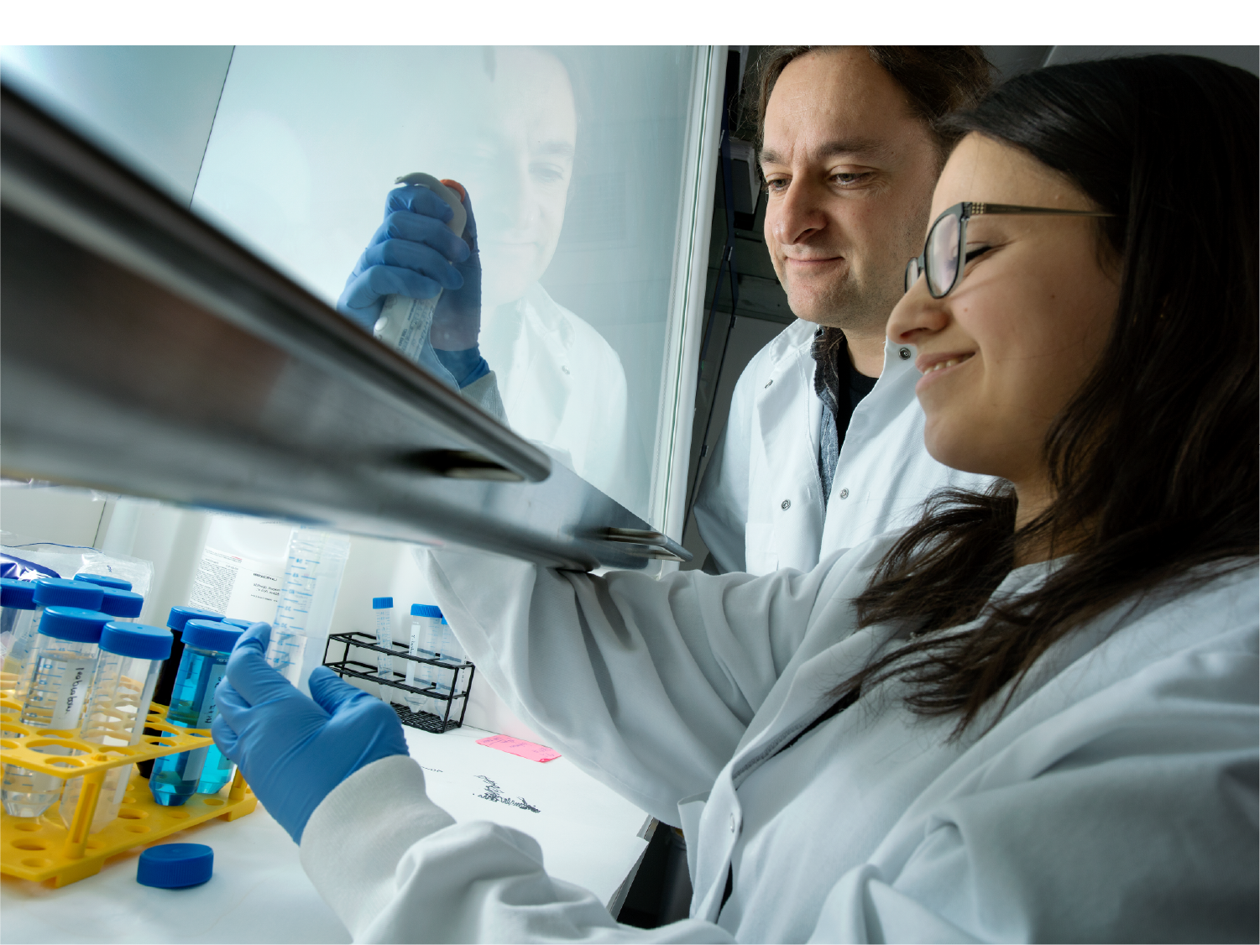
Basic research
IMPACT
Denmark is one of the world leaders in basic research.
Most of the projects uncover new knowledge that contributes to discoveries in prevention and treatment.
E.g. Professor Ali Salanti was developing a malaria vaccine for pregant women. His research created fertile ground for developing a new and promising treatment for cancer.
Notes:
BASIC RESEARCH IMPACT The picture shows Professor Ali Salanti from the Department of Immunology and Microbiology at SUND.
In 2003 Professor Ali Salanti, with the support of the Danish Council for Independent Research, was working on his PhD thesis, which aimed to develop a malaria vaccine for pregnant women in Africa.
At the time he was not aware that he was facing a breakthrough in the treatment of both malaria and cancer.
Historically, independent health research has delivered a series of main breakthrough, making the healthcare system more efficient through improved prevention, diagnostics, new treatment methods, new data basis and new technology.

Slide 27

Notes:
STRONG INTERNATIONAL AND INTERNATIONAL-DISCIPLINARY COLLABORATIONS

Slide 28
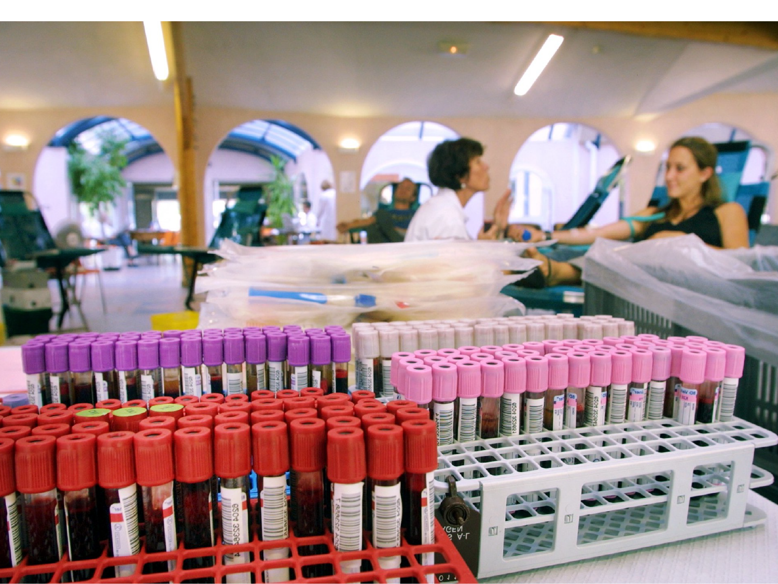
Collaboration
with hospitals
Professors and PhD students working at the hospitals in the Capital Region of Denmark and Region Zealand:
213 clinical professors (2019)
724 clinical PhD students (2019)
Notes:
COLLABORATION WITH HOSPITALS
The University Hospital of Copenhagen (KUH) is the organisational framework for the collaboration between the Capital Region of Denmark, Region Zealand and Health Sciences UCPH.
Clinical professors and clinical PhD students work at the hospitals in the Capital Region of Denmark and Region Zealand.
They contribute to education and research within health and disease.
Source: Department of Clinical Medicine

Slide 29
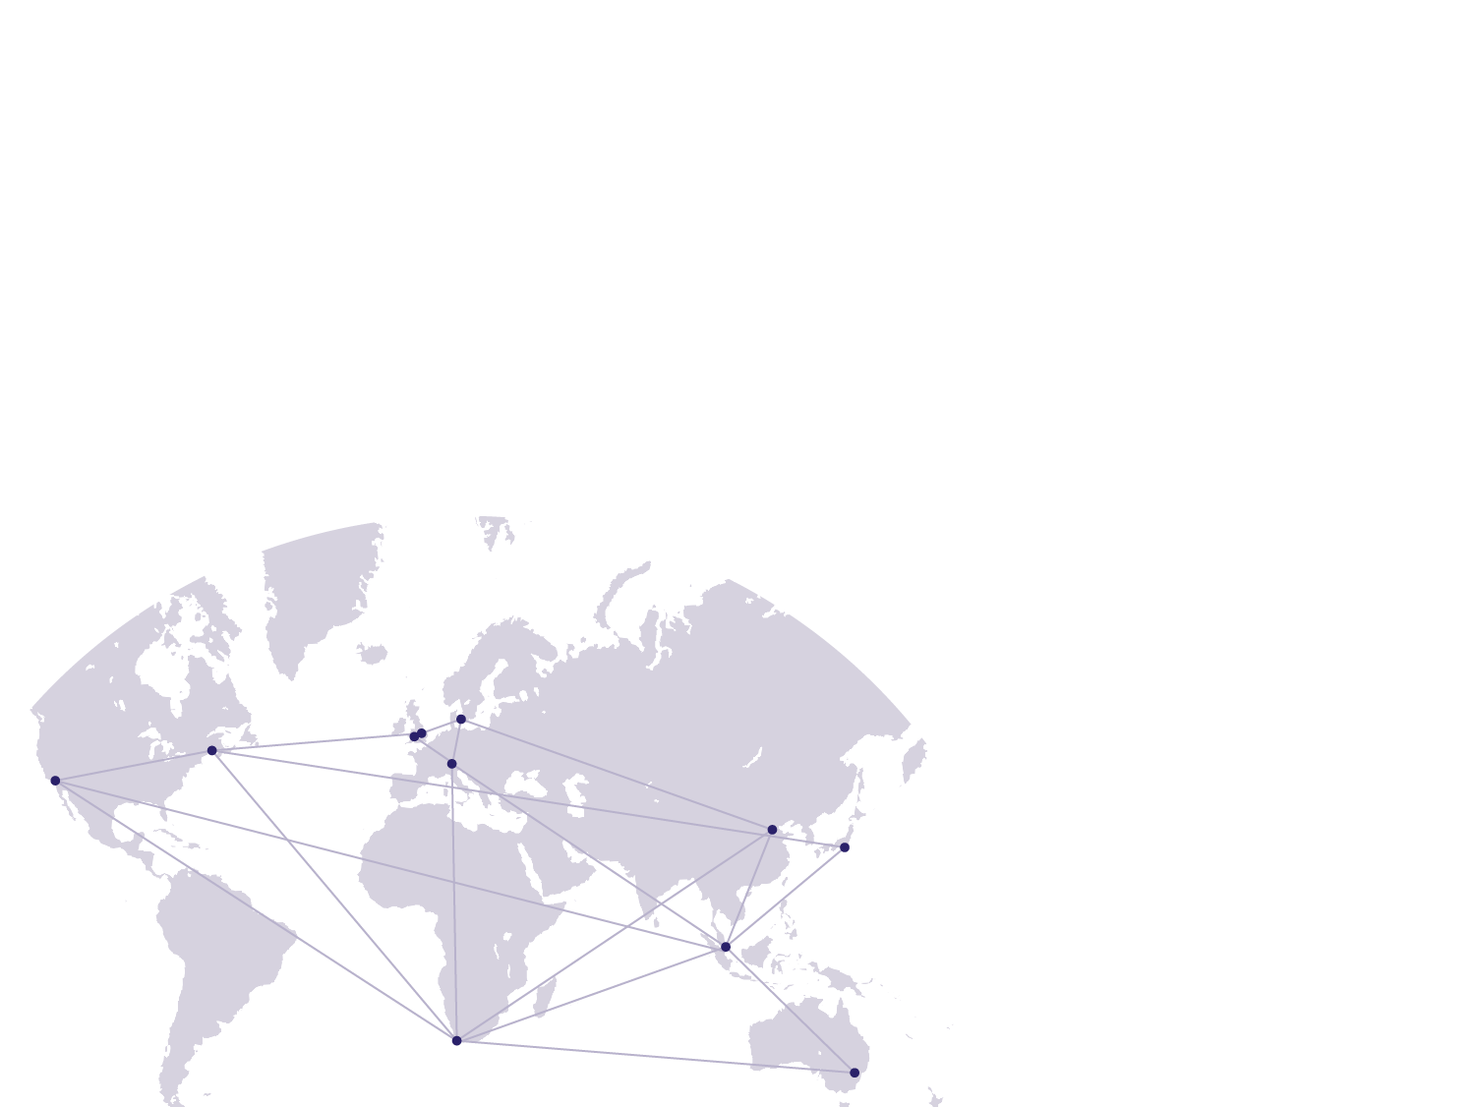
International Alliance of Research Universities (IARU)
Eleven of the world's leading research-intensive universities
The IARU Aging, Longevity & Health initiative is one of the earliest joint research initiatives formed by the Alliance in 2006
The initiative is led by the University of Copenhagen with SUND’s Center for Healthy Aging (CEHA) as a key actor.
Members:
Australian National University
ETH Zürich
National University of Singapore
Peking University
University of California, Berkeley
University of Cambridge
University of Cape Town
University of Copenhagen
University of Oxford
University of Tokyo
Yale University

Slide 30
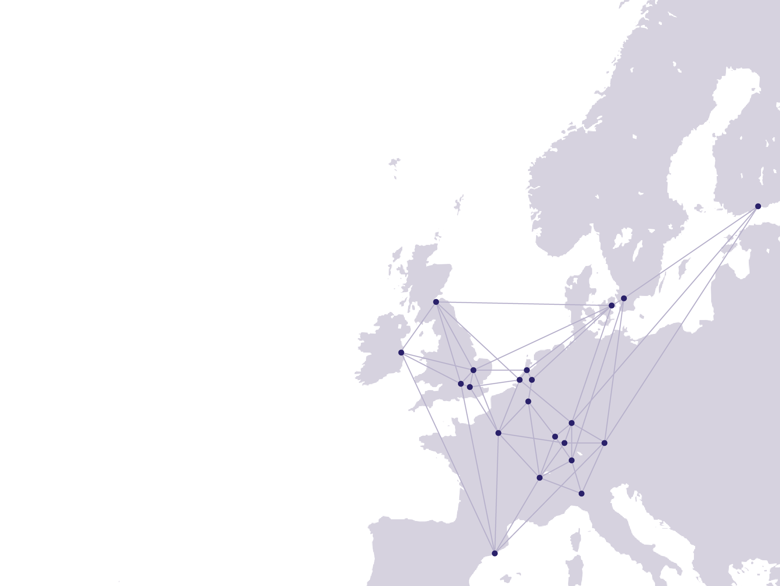
League of European Research Universities (LERU)
An exclusive European Network of some of
the most renowned research universities in Europe.
Members:
University of Amsterdam
University of Barcelona
University of Cambridge
University of Dublin
University of Edinburgh
University of Freiburg
University of Geneva
Heidelberg University
University of Helsinki
University of Copenhagen
Leiden University
University of Leuven
Imperial College London
University College London
Lund University
University of Milan
LMU Munich
University of Oxford
Sorbonne University
University of Paris-Sud
University of Strasbourg
Utrecht University
University of Zurich

Slide 31

Notes:
LEARN MORE ABOUT SUND

